Slide 1
Excel Internal assement 1
Lokesh

Slide 2
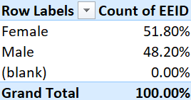
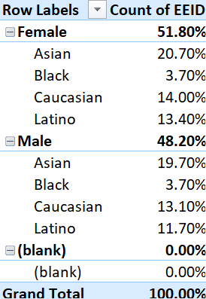
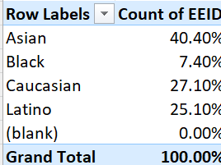
Q1.
Here we can see the overall distribution between the female and male and as well the ethnicity distribution. From this we know that there are more female employees than the male employees and most of them are Asian and the least are Black.

Slide 3
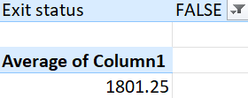
Q2.
The average days the employee saved are around 1801.25 days. Can check from hire to exit date.

Slide 4
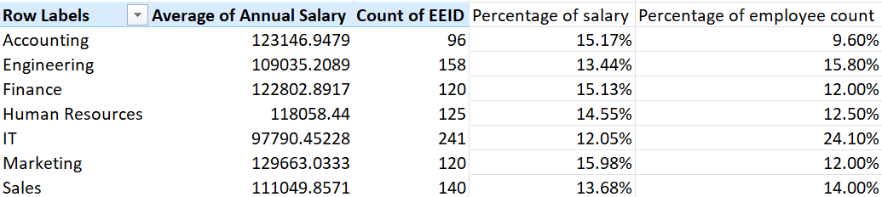
Q3
Yeah there are relatively slight difference in the average salary from one department to another. The average salary of the marketing department is high and the average salary of the IT department is low, there’s a difference of 3.95%.

Slide 5
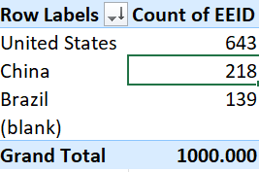
Q4.
United States has the most employess

Slide 6
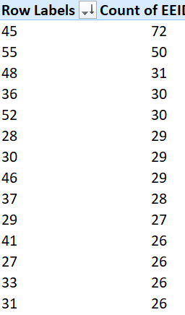
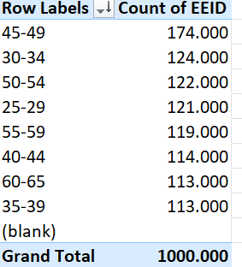
Q5
There are more number of employees in the age group of 45, and while comparing with the 5 age group, there are more employees between the age group of 45 to 49.

Slide 7

Q6
The average bonus of an employee is 8.866%, since most of the employees doesn’t receive any bonus.

Slide 8
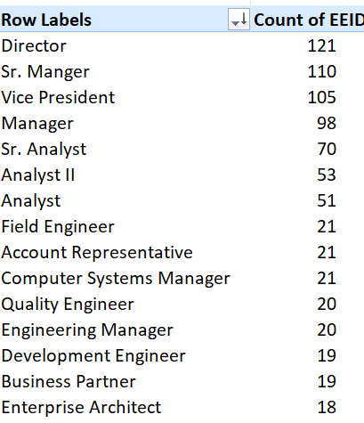
Q7
The director title appears the most cause, each department has a director in it

Slide 9
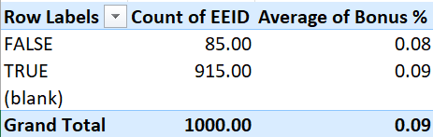
Q8
Around 85 peoples have exited the company, reasons is the age and role promotion.

Slide 10
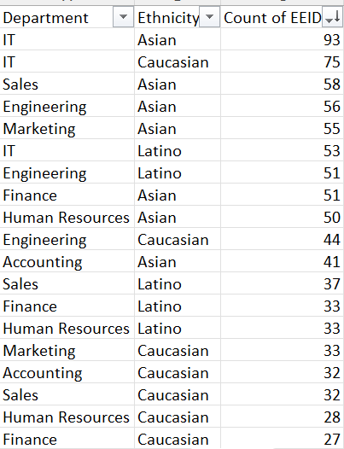
Q9
We can see that the most employees from the IT department is Asian and Caucasian. And we could conclude that departments is diverse based on ethnicity.

Slide 11
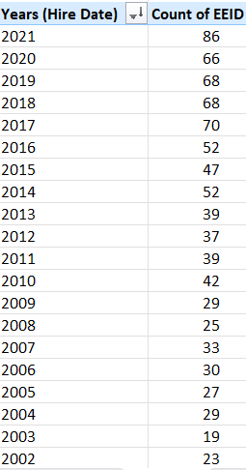
Q10
From the table we can see that the hiring rates is been steadily increasing for the current years compared to the past years.

